Slide 1
Network Systems
Jose Santos
Instructor

Slide 2
Are you taking the right class?
Course geared towards graduate students who have not taken Network Systems before
Alternatives:
CSCI 7000 Advanced Network Systems (Eric Keller)
CSCI 5160 Intro to Enterprise Networks
CSCI 5280 Software Defined Networks
CSCI 5260 Datacenter Networks
CSCI 5360 Service Provider Networks
CSCI 5180 Network Management and Automation
CSCI 5380 Network Virtualization and Orchestration
https://www.colorado.edu/cs/academics/graduate-programs/professional-masters-network-engineering

Slide 3
Course workload
Syllabus at canvas
Midterm: 20%
Literature Reviews: 10% ( 2 paper summary, 1 video presentation)
Weekly Quizzes: 10%
Problem Sets: 20% (physical layer, ethernet/IP, routing TCP, hashing)
Programming Assignments: 20% (socket programming, webserver, proxy, hash storage)
Final Exam 20%

Slide 4
If this is the right class
How do you want to conclude the course?
Final Exam
Last 3 classes paper review presentation/lecture
Final Project
Last 3 classes project presentation / demo
Project definition by week 5
Project milestone by week 10
Project demo/presentation by week 15
Implies 2 parallel programming tasks (short term individual / long term team)

Slide 5
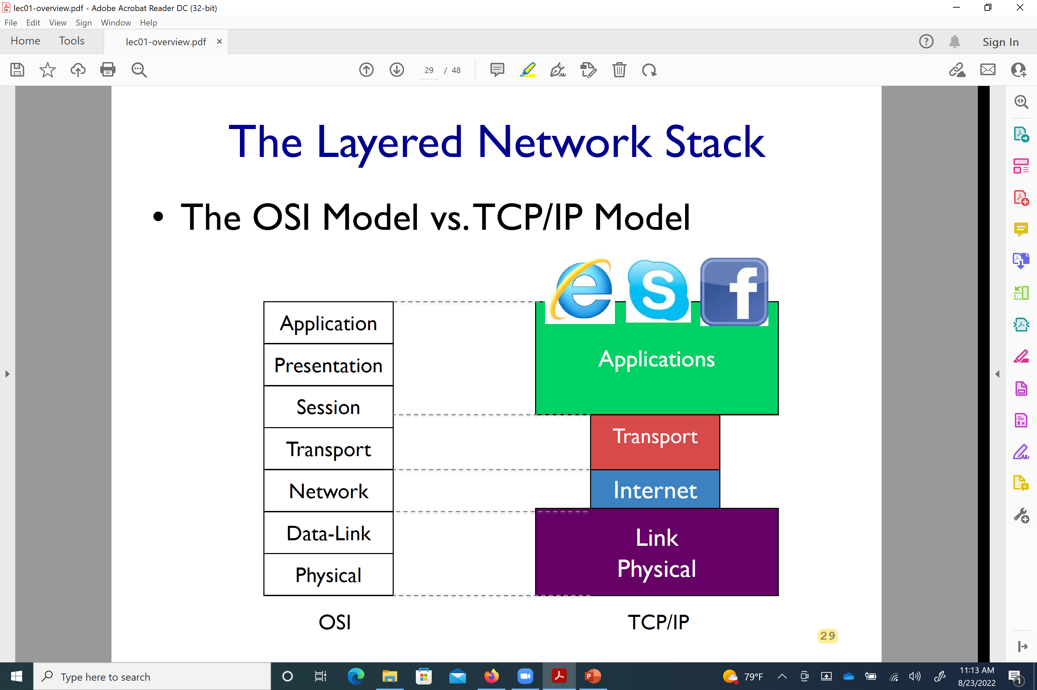
OSI / TCP/IP Models

Slide 6
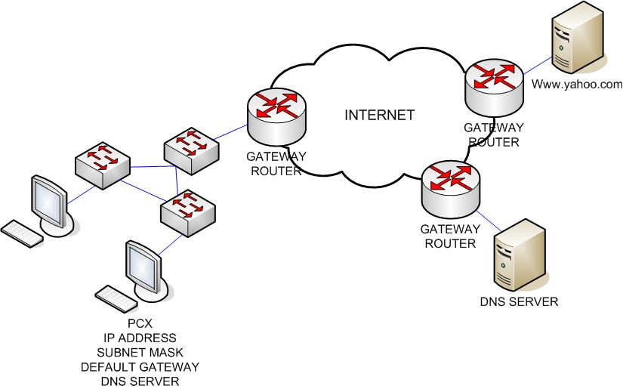
My approach: http://yahoo.com

